Slide 1
7 C’s of Communication

Slide 2
Effective communication
Effective communication takes place only when the listener clearly understands the message that the speaker intended to send.
A speaker’s message must be delivered clearly.
A listener must be an active listener.
Applicable to both written and verbal communication

Slide 3
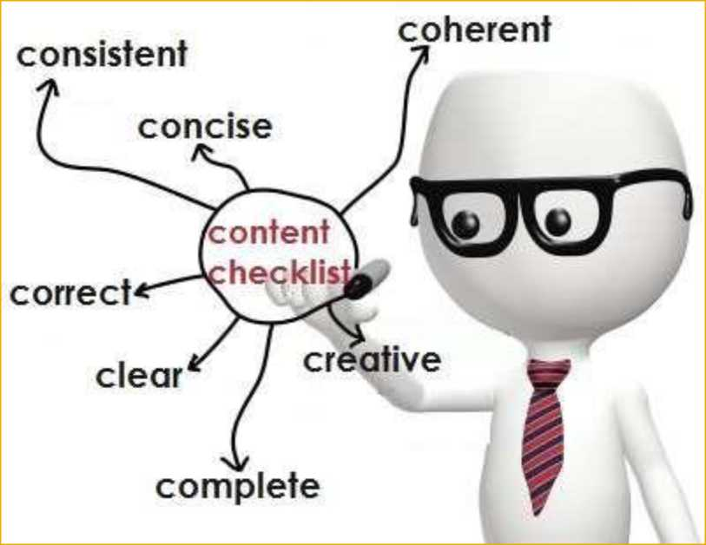
The 7 C’s
Completeness
Conciseness
Consideration
Concreteness
Clarity
Courtesy
Correctness

Slide 4
Completeness
The communication must be complete.
It should convey all facts required by the audience.
The sender must take into consideration the receiver’s mind set.
Features:
No crucial information should be missing.
Gives additional information.
Leaves no questions unanswered.

Slide 5
Check for five Ws & one H for completeness
Who
What
When
Where
Why and
How

Slide 6
Conciseness
It means wordiness - communicating
what you want to convey in least
possible words.
Features:
Highlights the main message.
Avoids using excessive and needless words.
Provides short and essential message in limited word.
Message becomes appealing and comprehensible to the audience.

Slide 7
Consideration
Implies “stepping into the shoes of others”.
Take note of audience’s view points, background, mind-set, education level, etc.
Envisage your audience, their requirements, emotions and problems.
Do not hurt self-respect and emotions of audience .
Modify your words to suit the audience’s needs Features :
Emphasize on “you” approach. Show optimism towards your audience.
Empathize and exhibit interest in audience to stimulate a positive reaction

Slide 8
Concreteness
Be particular and clear rather than fuzzy and general.
It strengthens the confidence.
Concrete messages are not misinterpreted.

Slide 9
Clarity
Clarity emphasize a specific message or goal at a time, rather than trying to achieve too much at once.
Features:
It makes understanding easier.
Clarity of thoughts and ideas enhances the meaning.

Slide 10
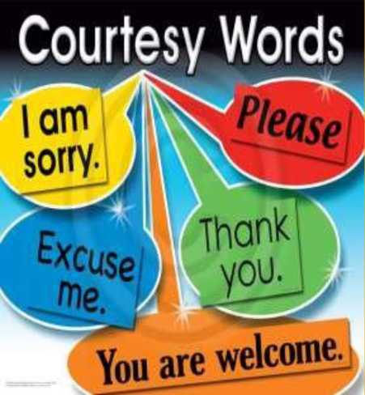
Courtesy
The sender of the message should be sincere, polite, judicious, reflective and enthusiastic towards listener or writer.
Take into consideration both viewpoints and feelings of the receiver.

Slide 11
Correctness
It Implies there should not be grammatical errors in communication.
Features:
The message is exact, correct and well-timed.
Correct communication, boosts the confidence level.
Correct message has impact on the audience/readers.

